Slide 1

PS-1 Seminar II
Coditation Systems Pvt. Ltd.
Pathik Shah (2021A7PS2085G), Joel Tony (2021A7PS2077G), Aayush Kumar Singh(2021A7PS0430H)

Slide 2
Coditation Systems
Coditation was founded by Chetan Saundankar in 2017 with a vision of creating a boutique firm specializing in application of emerging technologies
A team of skilled software architects, engineers, and data scientists who excel at solving complex problems and delivering high-quality solutions.
Expertise in Graphics Programming, Realtime Apps and WebRTC.
Mature data science team to build cutting-edge ML and AI products.
Specialized in creating exceptional user experiences across UIs, Micro-frontends, and Mobile Apps.

Slide 3
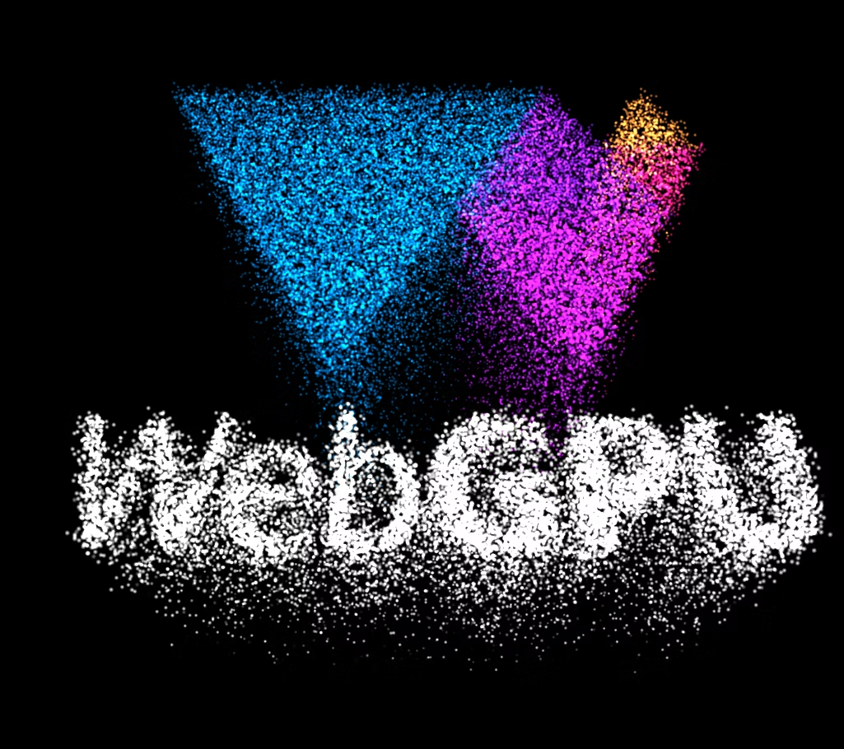
Outline
About Coditation Systems
Introduction
Initial Divisions
DevSync
Compiler Infrastructure
WebRTC
WebGPU
WebGPU
Basic Implementation
gLTF Model Rendering
Challenges
Point Clouds
Open 3D
Three js

Slide 4
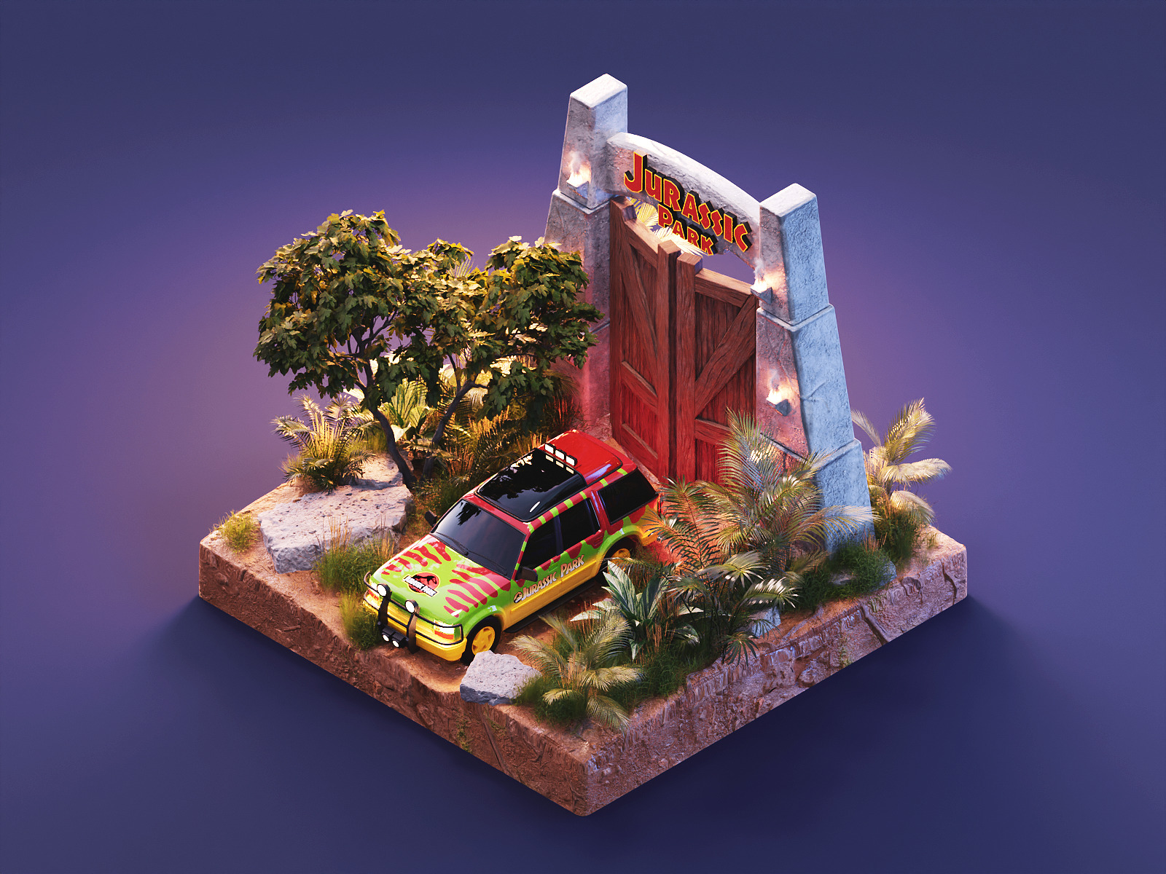
Project Boxxy
For developers and researchers working on resource-intensive tasks, Project Boxxy aims to provide affordable and accessible GPU resources. High-end GPUs are currently prohibitively expensive for both individuals and businesses. We mainly aim to solve this problem by providing a sandbox environment for the creation and deployment of graphic intensive scenarios.
The project also aims to support point cloud rendering of 3D models and scenarios in the future

Slide 5
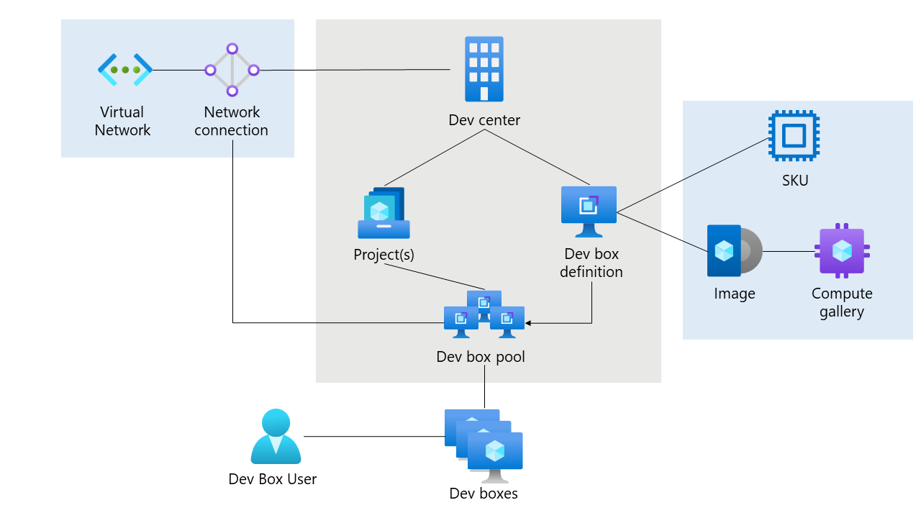
Initial Divisions
DevSync
Enable hot reloading of graphics viewport
Seamless development experience for remote graphics developers
Integration of development tools and frameworks for live code updates
Implementation of hot module replacement for improved efficiency
Facilitating remote collaboration on graphics payloads

Slide 6
COMPILER INFRASTRUCTURE
Explored linking libraries in large-scale projects using different build systems.
C++ compilation process deepdive
Read about task-based and artifact-based Build Systems.
Chosen approach: CMake for managing the C++ project and Bazel for remote caching as the project scales in future.
Gained insight into linking libraries with CMakeLists and integrating package managers like vcpkg as git submodules.

Slide 7
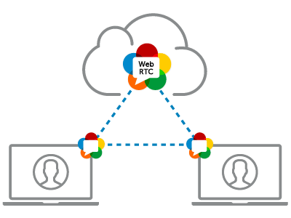
WebRTC
The WebRTC team had to figure out how to stream the graphics rendered to the web
They also had to make sure that the stream would support a variety of the most popular browsers that the current consumers use like Google Chrome, Mozilla Firefox, etc.
To ensure secure and efficient streaming of the graphics data

Slide 8
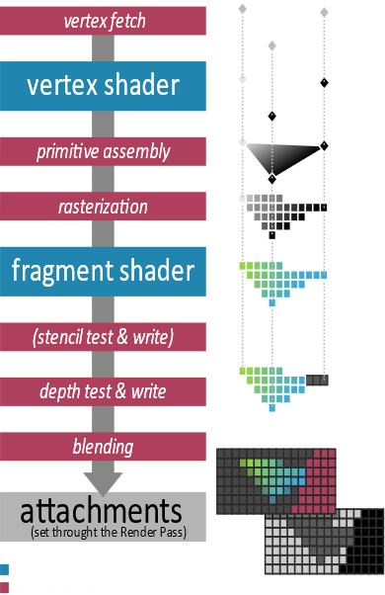
WebGPU
Graphics Programming Fundamentals: Covers vertex buffers, vertex shaders, and fragment shaders.
Rendering Pipeline: Vertex Fetch,Vertex Shading, Rasterization, Blending
Shading Languages: Introduces WGSL and supports GLSL and SPIR-V.
WebGPU: Cutting-edge low-level graphics API succeeding WebGL, ensuring platform agnosticism.
Core Engine Features: glTF(gl Transmission Format) loader and covers pipeline layout, render architecture, swap chains, and texture views.

Slide 9


WebGPU Backends: Backend implementations by Chromium (Dawn (C++)) and Mozilla (WGPU-Native(Rust)).
(Chromium)

Slide 10
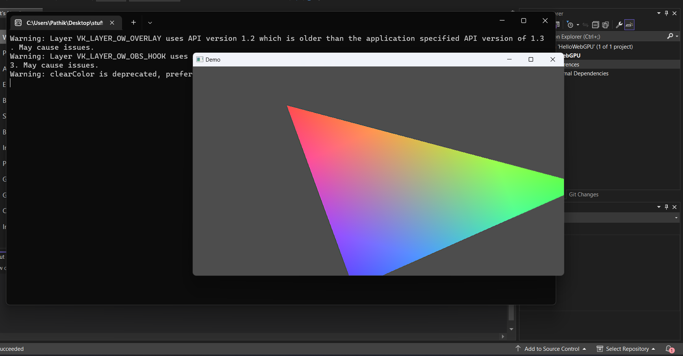
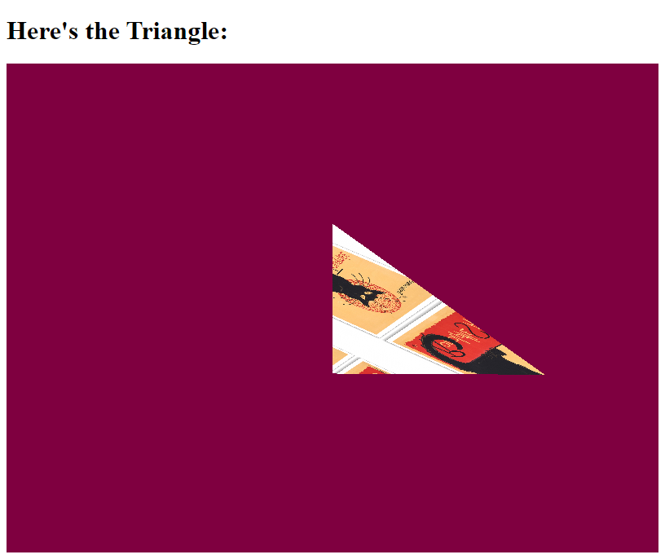
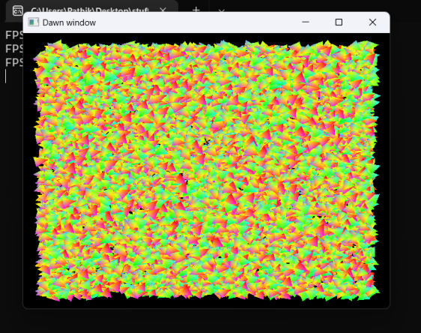
Basic Implementations
Triangles and Squares using OpenGL for understanding fundamentals.
Hello-triangle on our machines using WebGPU-Native
Textured triangles using WebGpu-Web.
A starter project involving glTF loader.

Slide 11
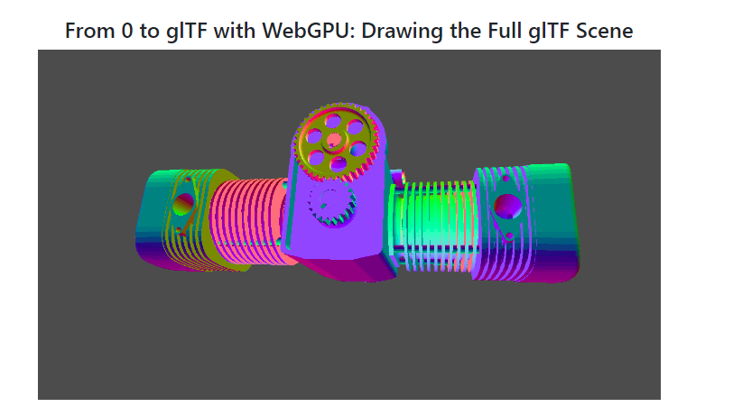
glTF Model
GLTF (GL Transmission Format): Open standard file format for 3D scenes and models, designed to be lightweight and efficient for use in real-time applications.
Developed by the Khronos Group(consortium that developed the OpenGL and Vulkan).
Compact binary format that can be easily loaded and rendered by graphics engines and web browsers.
Platform-independent

Slide 12
Challenges Faced during WebGPU phase
Unable to compile Dawn-chromium webgpu implementation. We shifted our main project from Dawn to WGPU-native by Mozilla due to same reason. Also, for using Dawn we started using precompiled binaries.
Another issue was constantly changing spec of WebGPU. We had to verify some parts from the official documentation.

Slide 13
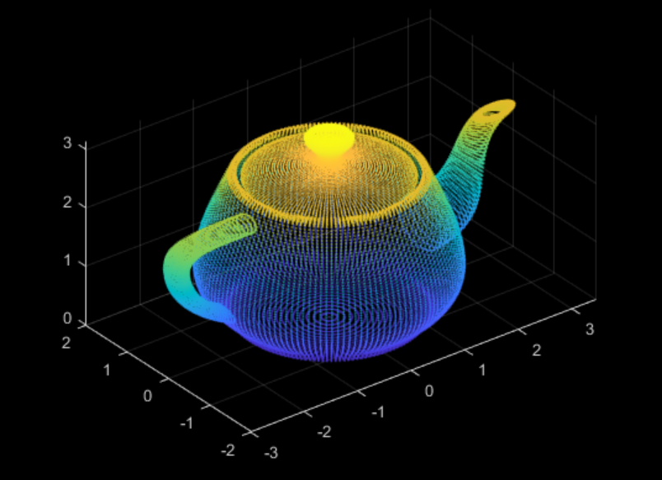
Point Clouds
Collection of data points in 3D space
Generated by 3D scanners & LiDAR (Light Detection & Ranging)

Slide 14
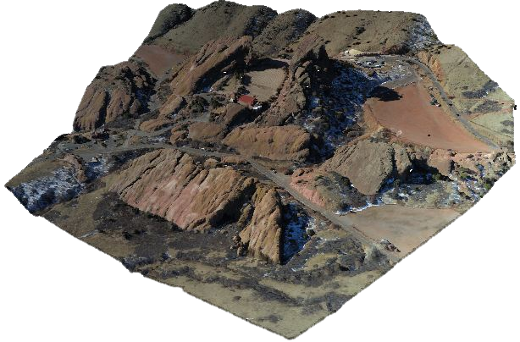
Applications of point clouds
3D modelling
Landscape planning
Medical imaging
Reverse engineering
Autonomous vehicles

Slide 15
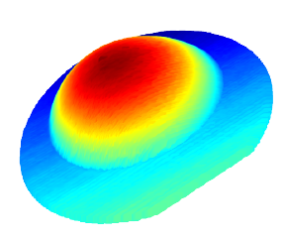
Point Clouds in Open3D
Open-source library for 3D data processing
Written in C++. Python API available
Rendered a heatmap representation of a tumour
Data was in proprietary binary format, obtained from 3D scanner

Slide 16

Three.js
Javascript library which acts as a WebGL wrapper
Handles entire rendering pipeline (geometries, lighting, shading)
Investigated point cloud rendering using the PCD format

Slide 17
Implementation Plan
Utilise Three.js’s PCD loader or Potree (WebGL-based point cloud renderer)
Consider porting to WebGPU for high performance 3D graphics
Create a native WebGPU version to optimize rendering process and enhance performance

Slide 18
Questions?

Slide 19
Thank you

